Slide 1
CITIBIKE AIN’T GOT FLOW Will Bartlett NYC Data Science Academy 2006 July Bootcamp

Slide 2
Objectives:
To visualize usage of citibikes by time.
Specifically, the flow of bikes into and out of individual stations.
To demonstrate citibike’s flow/distribution.

Slide 3
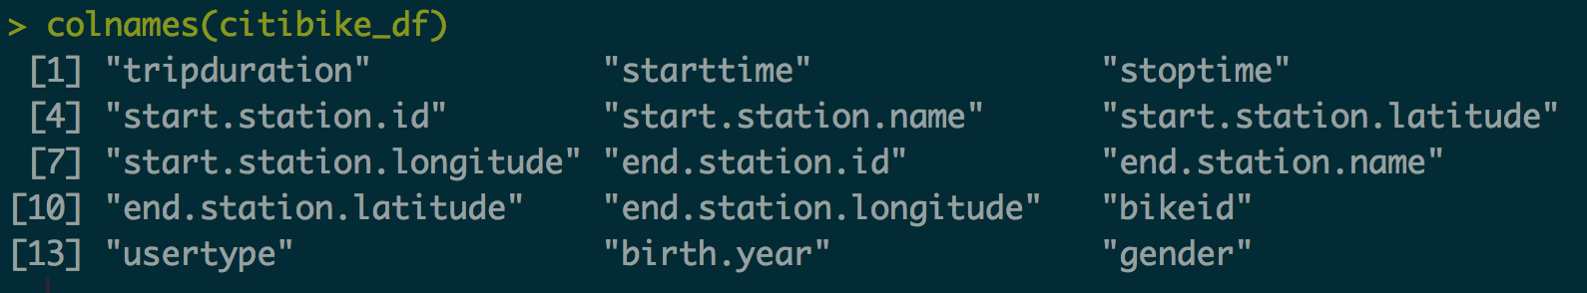
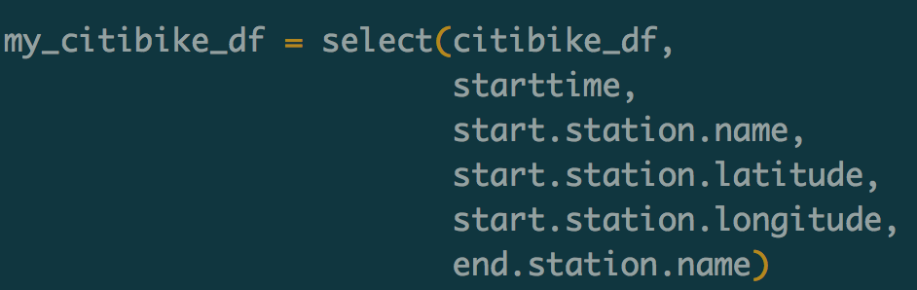
Data: Public CITYBIKE trip data for month of June, 2016 (Last Month) *colnames returns the column names of the indicated data table.

Slide 4
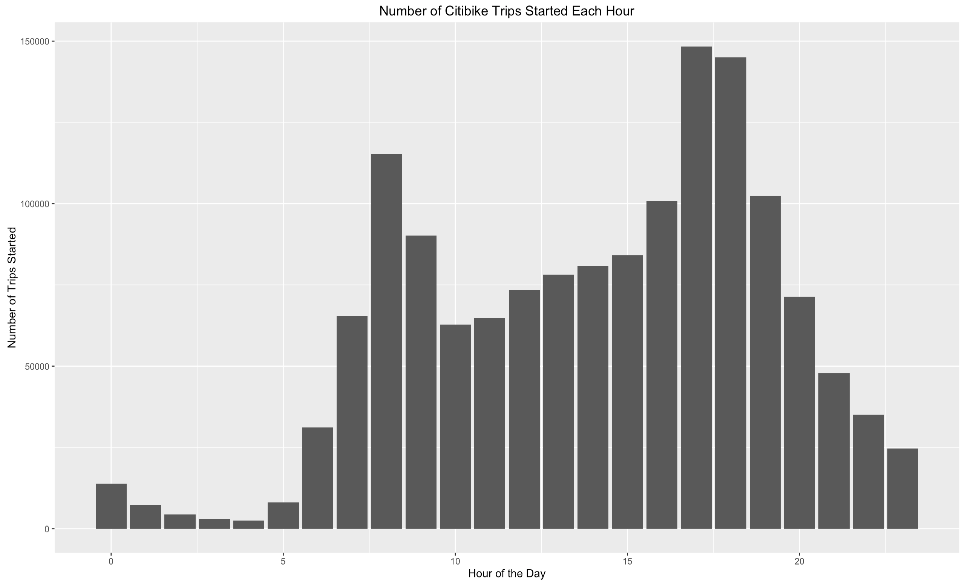

Slide 5
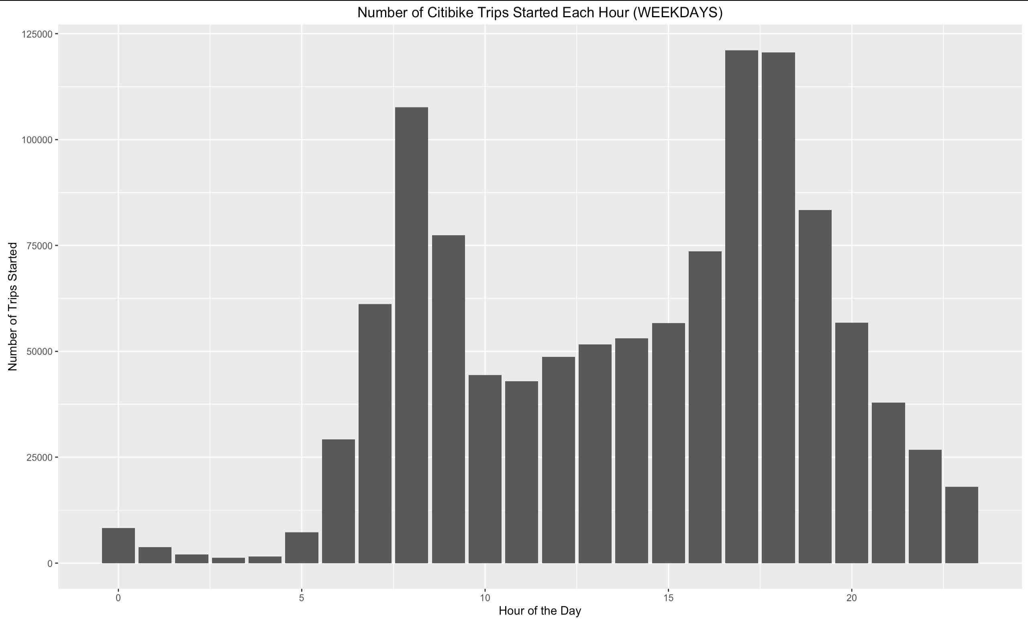

Slide 6
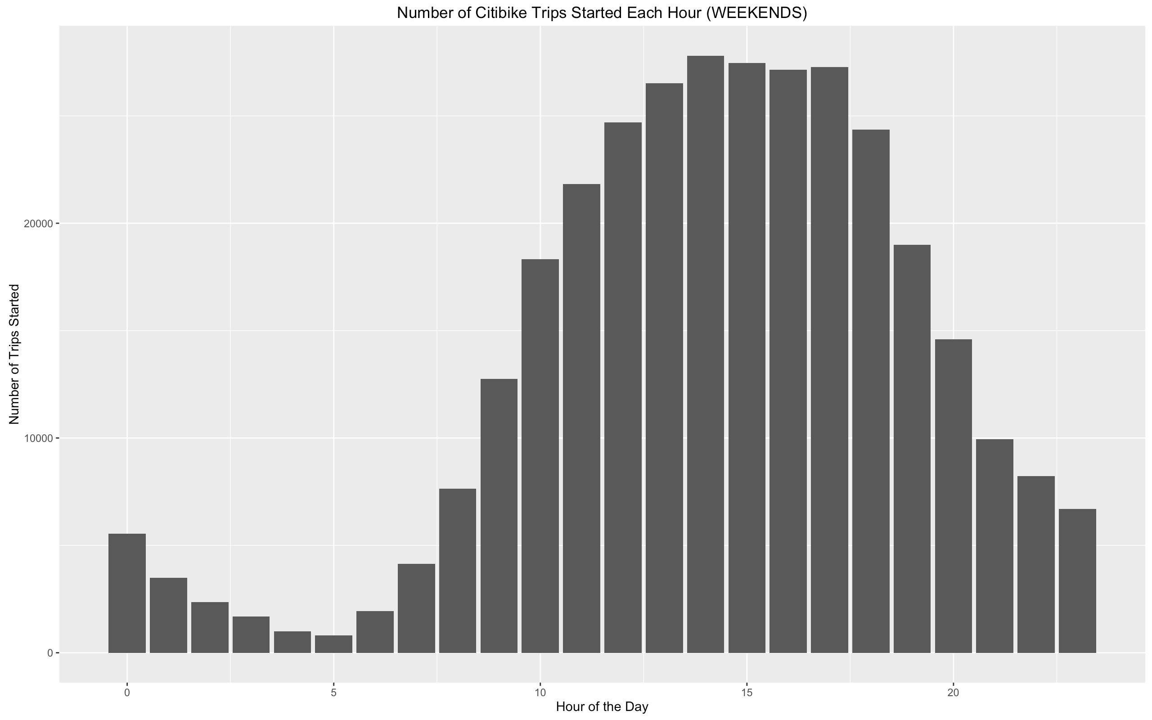

Slide 7
THE REST OF THE GRAPHICS SHOW WEEKDAY DATA

Slide 8
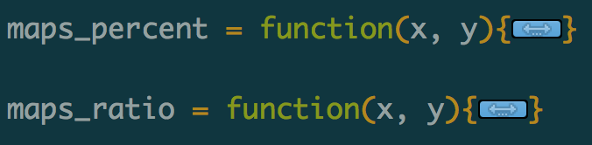
2 Functions…
maps_percent = creates a map that shows, for the given time window, the percentage of all trips that happened at each particular dock (~docks that get the most start traffic~).
maps_ratio = creates a map that shows, for the given time window, the ratio of starting trips to ending trips at each dock. (~flow balance of each dock~).

Slide 9
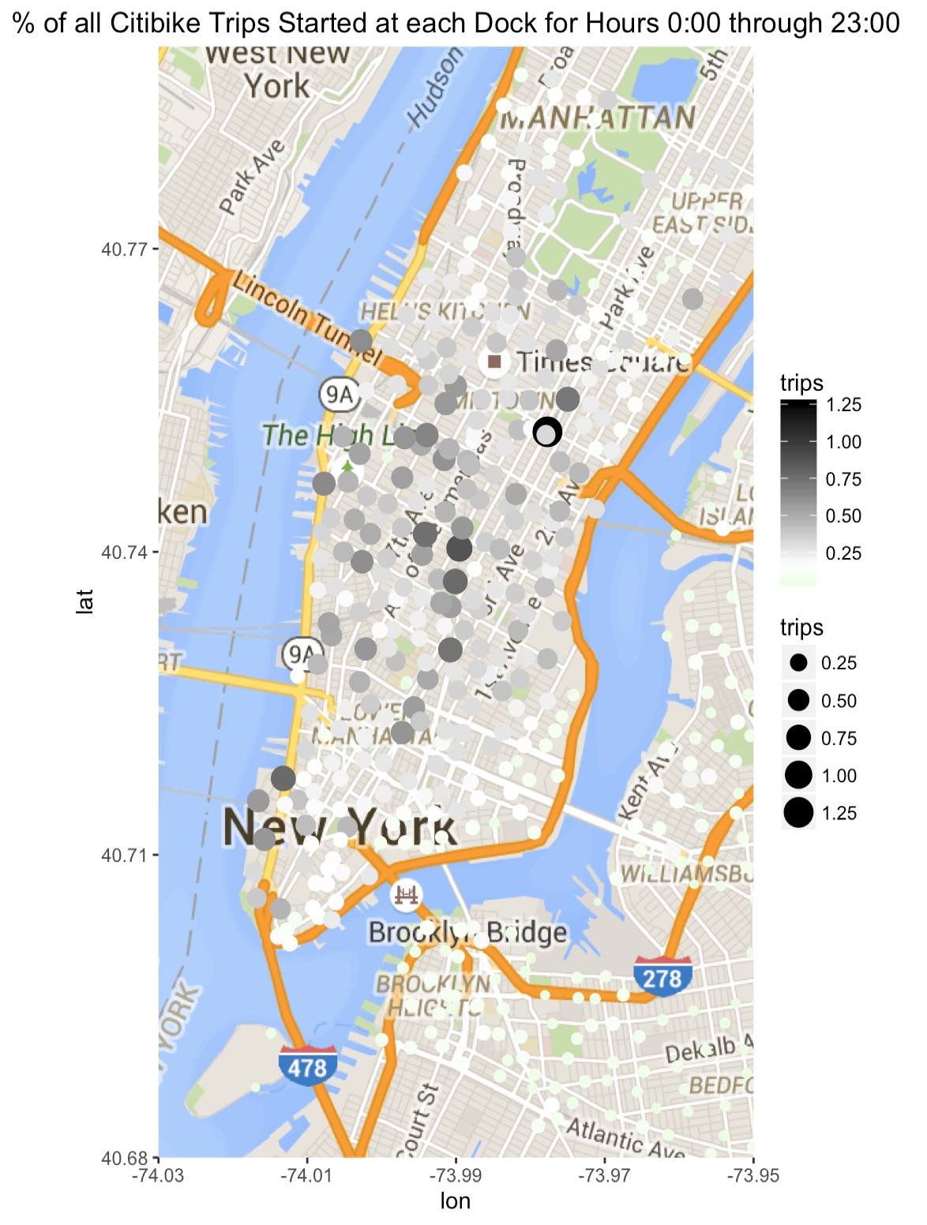
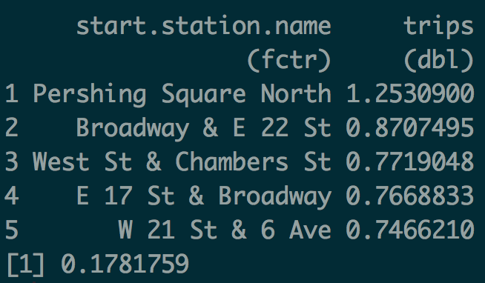

Slide 10
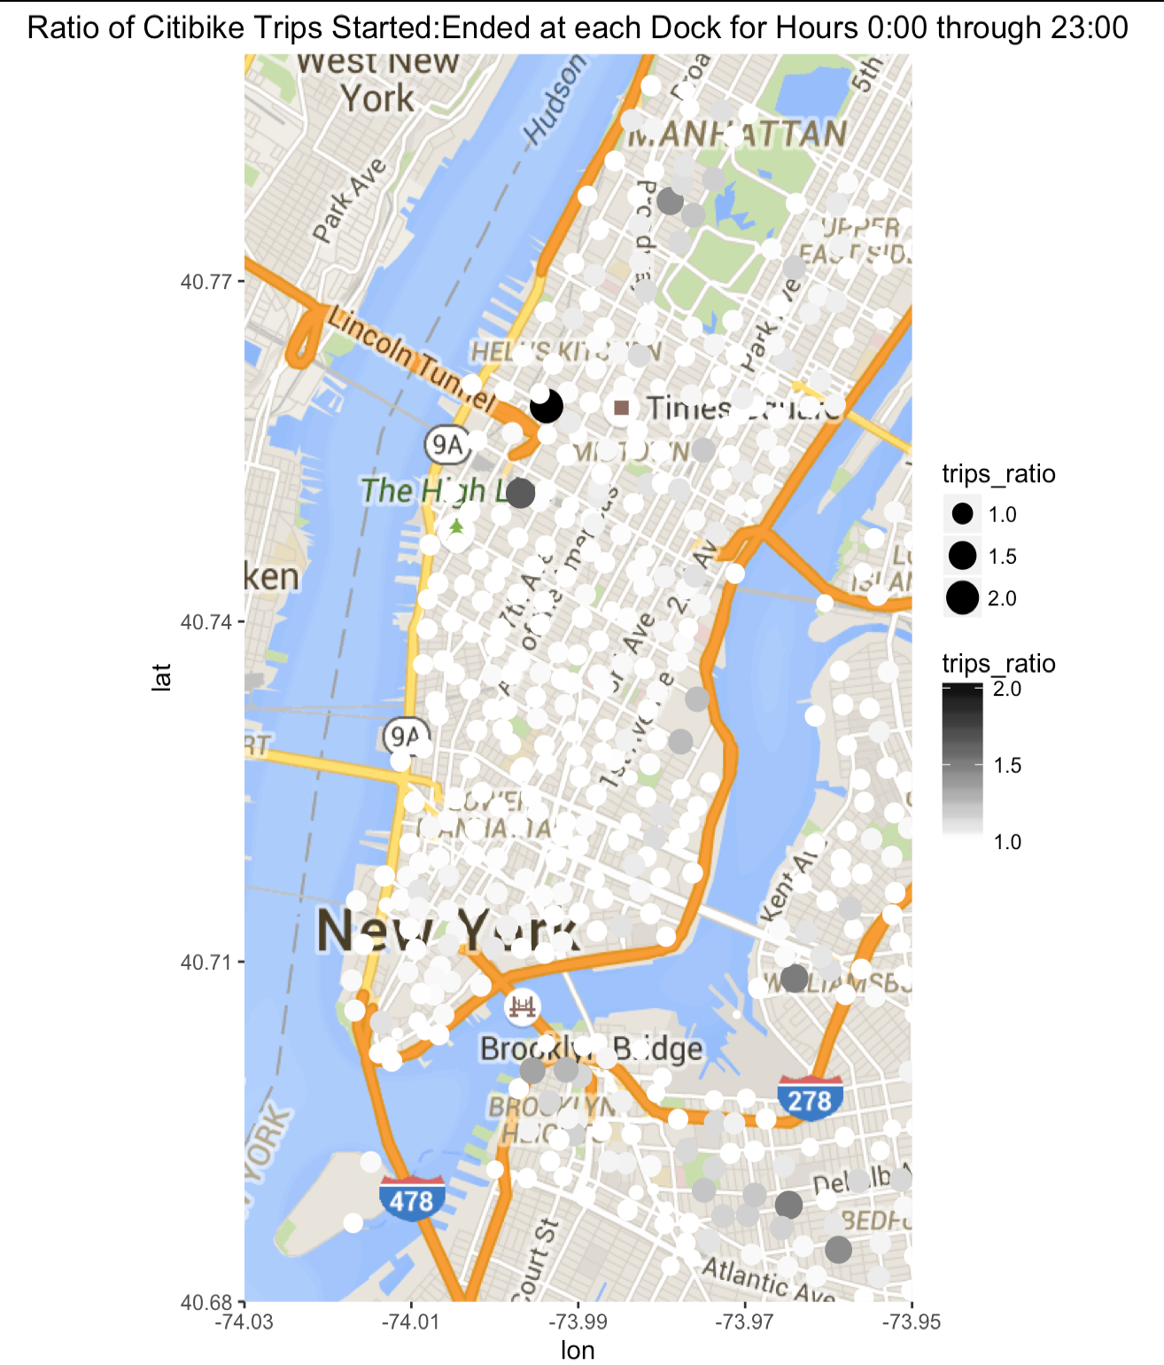
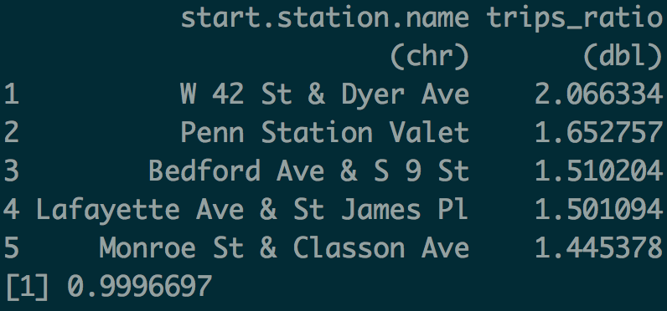

Slide 11
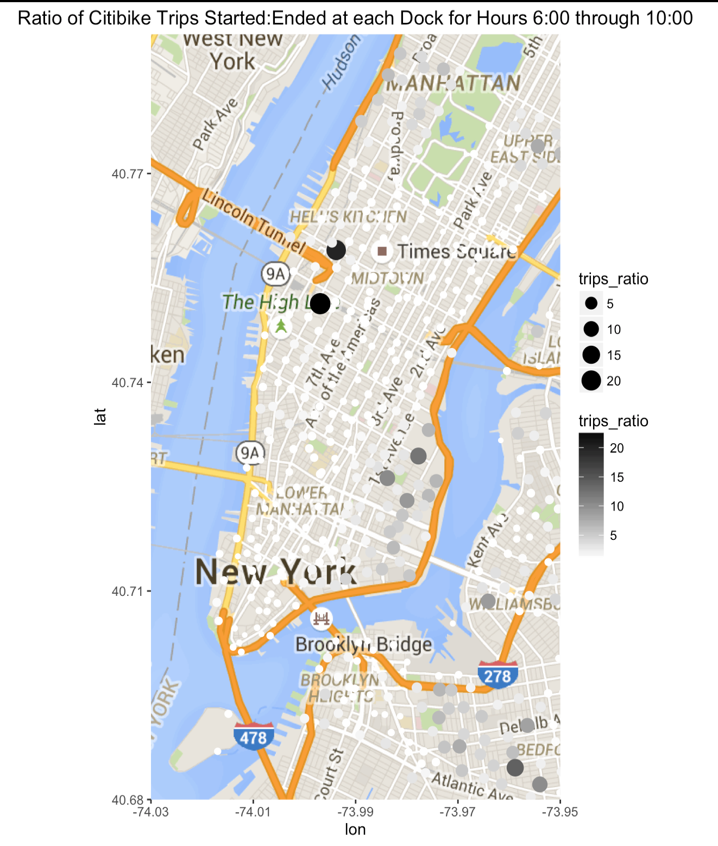
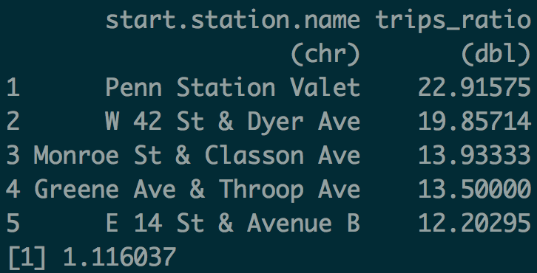

Slide 12
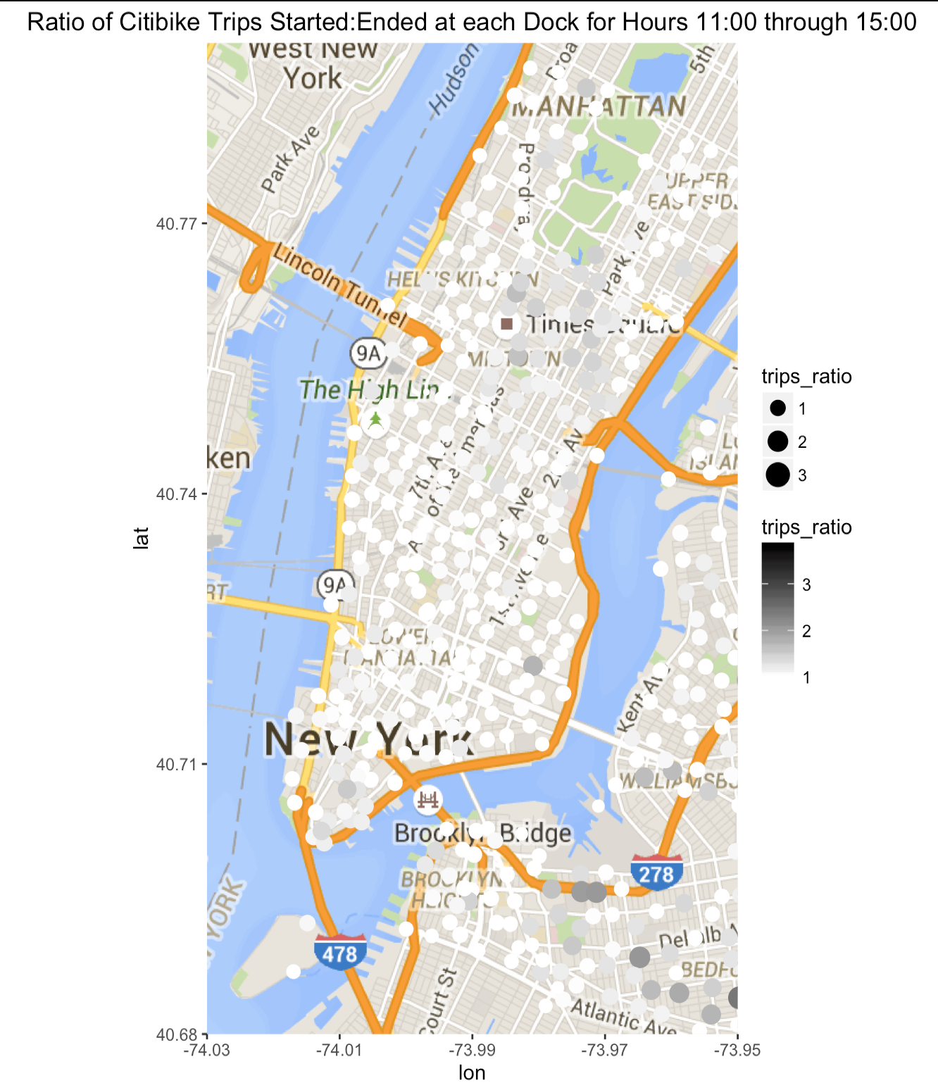
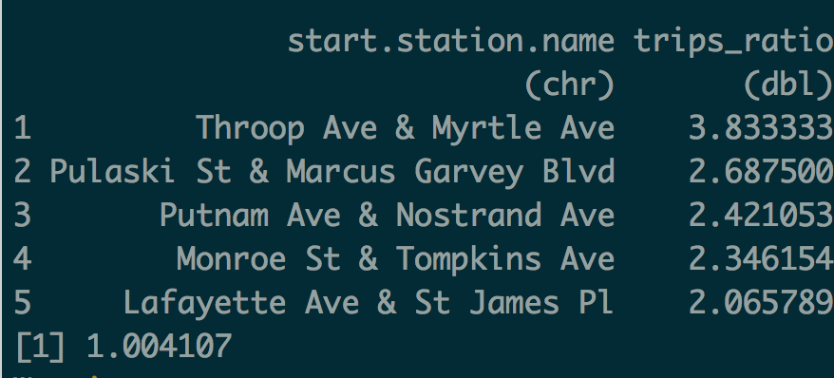

Slide 13
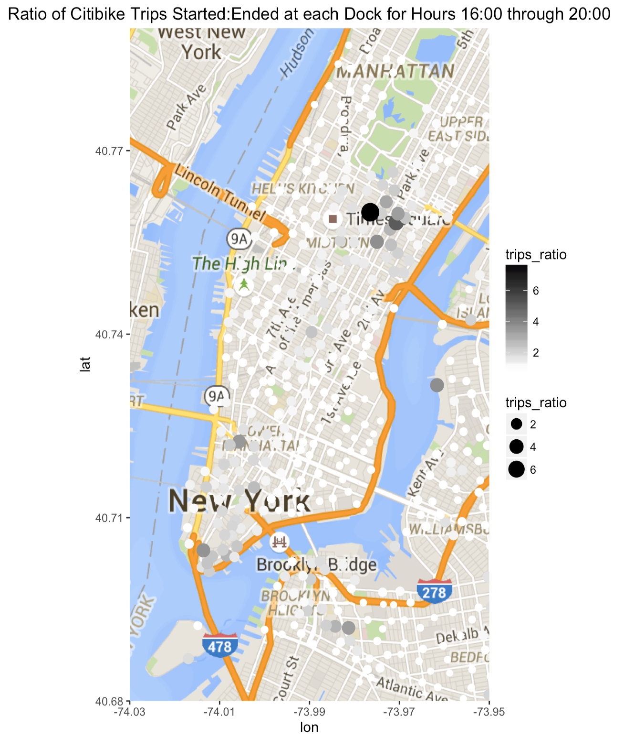
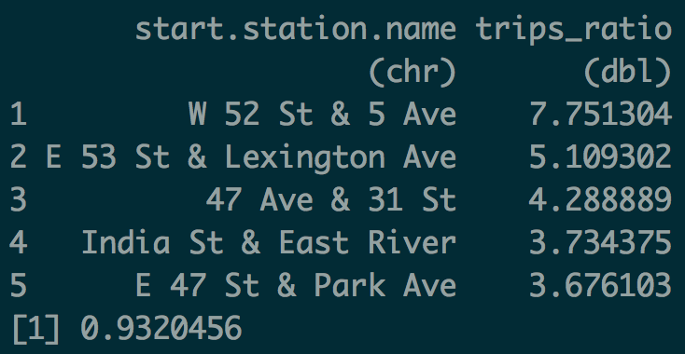

Slide 14
With more time…
Compare docks by revenue generated as well as activity.
Subscriber vs single payer patterns (commuters vs tourists?).
Usage Patterns by Time of Year

